Slide 1
The role of innovation for digitalizing the power grid
Welcome and Introduction

Slide 2
ROMANIAN ENERGY CENTER - CRE
The Romanian Energy Center is a non-governmental and non-profit Association representing the interest of state-owned and private companies operating in the Romanian Energy Market, in relation with EU and National Institutions → Since 2011 in Brussels and Bucharest
Active in all relevant areas including: electricity, oil and gas, coal, renewables, energy equipment and services plus R&D&I, and Legal assistance
CRE contributes to the European and National decision-making process, promotes infrastructure investments and supports the transition to a decarbonized energy system
Position Papers - Romanian and European Energy Policy Consultations

Slide 3
ROLE OF INNOVATION IN
EUROPEAN PROJECTS AT CRE
Setting-up INNOVATION Activities → Implementation and Commercialisation of NEW PRODUCTS & SERVICES
EXEMPLES: SUCCESS Project → Solution to Protect the Electricity Distribution Grid against Cyber Attacks implemented in Romania, Italy, Ireland, Germany
SOGNO Project: Services for Grid Operators: State Estimation (SE), Power Control (PC), Fault Location Isolation and Service Restoration (FLISR), Load and Generation Forecasting (LGF), Power Quality Evaluation (PQE)
Access to European Funds to support Innovation Activities of CRE Members as Direct Members of European Consortia: ELECTRICA, CEZ ROMANIA, E.ON ROMANIA (DELGAZ), TRANSELECTRICA, TELEKOM, ROMGAZ and Partners: TELETRANS
Financial Source of the CRE Association Activities by the use of up to 25% of Total Direct Costs of EU Projects

Slide 4
EU PROJECTS TIMELINE - CRE

Slide 5
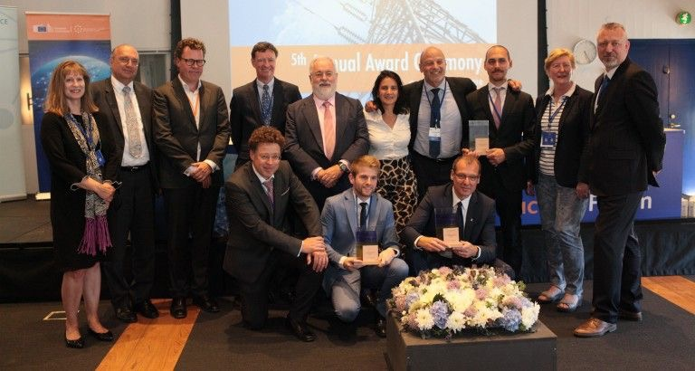
‘Good Practice of the Year’ awards
from EUROPEAN Commission
WiseGRID consortium receives ‘Good Practice of the Year’ awards from Commissioner for Energy, Miguel Arias Cañete
Technology
and
Design
Energy Infrastructure Forum 24 May 2018 Copenhagen
Energy Infrastructure Forum 24 May Copenhagen

Slide 6
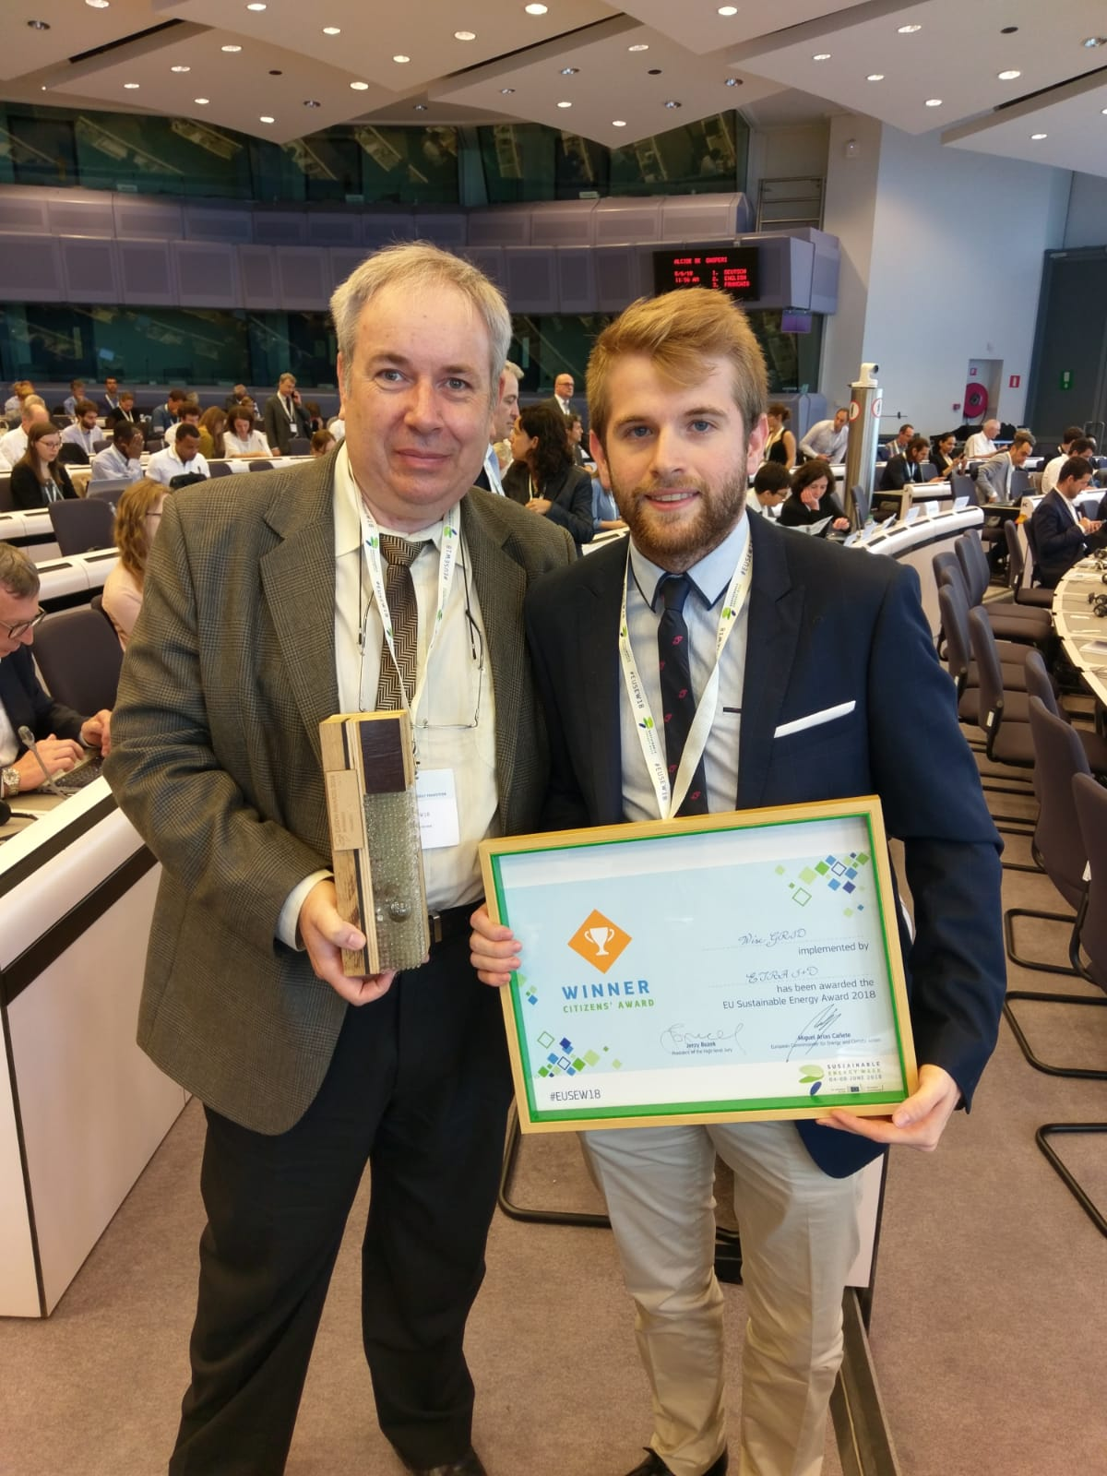
two EU SUSTAINABLE ENERGY AWARDS from Commissioner for Energy
The Best Project in the Business and Citizen's choice categories, winning two EU Sustainable Energy Awards
The prizes recognise outstanding Innovation In Energy Efficiency And Renewables
European Sustainable Energy Week 5 June Brussels (EUSEW 2018)
WiseGRID consortium WINes ‘two EU Sustainable Energy Awards from Commissioner for Energy, Miguel Arias Cañete
Energy Infrastructure Forum 24 May Copenhagen

Slide 7


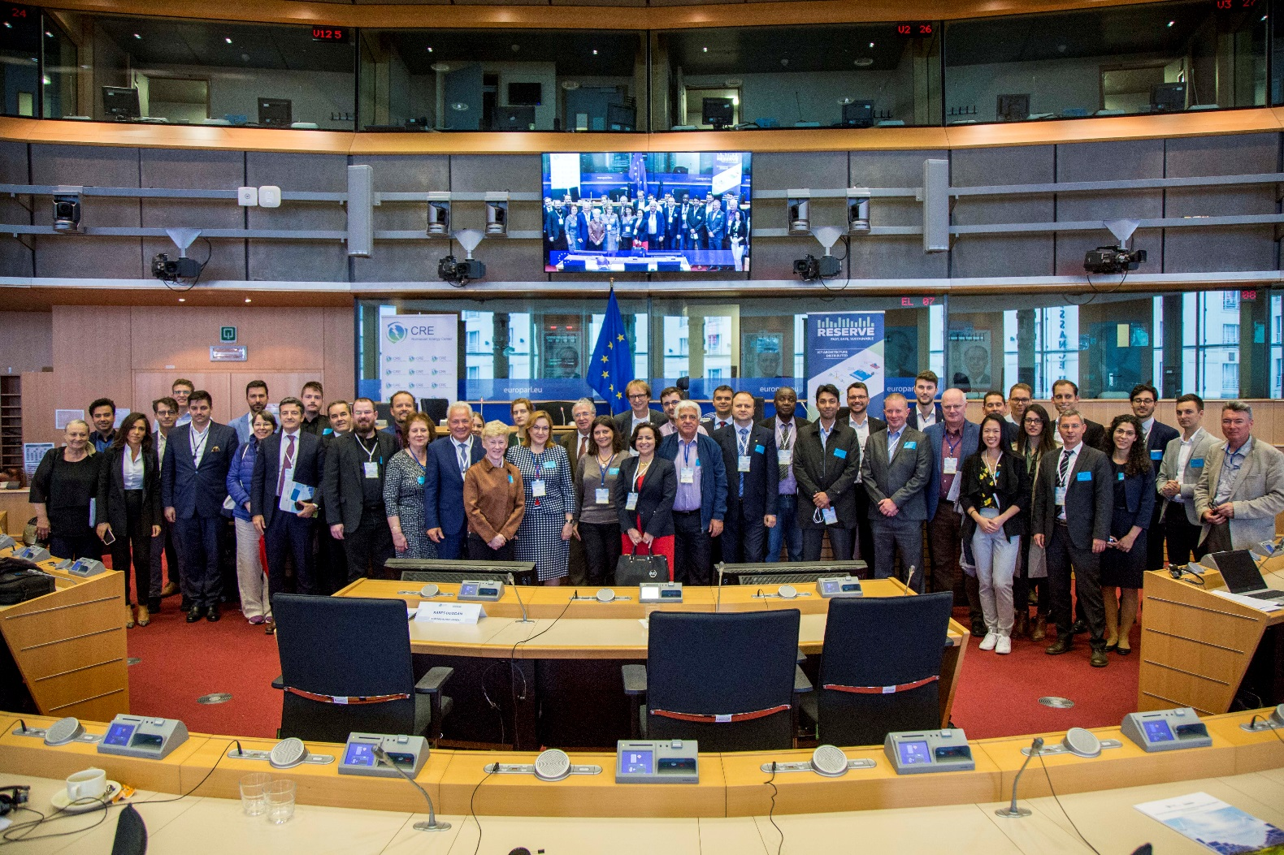
Debate on UP TO 100% RES
at the European Parliament

Slide 8

Frank HAJDINJAK
Romanian Energy Center
Frank.Hajdinjak@crenerg.org

