Slide 1
European Standards role fostering the digitalization of the energy sector
Elena Santiago-Cid, CEN and CENELEC Director General

Slide 2
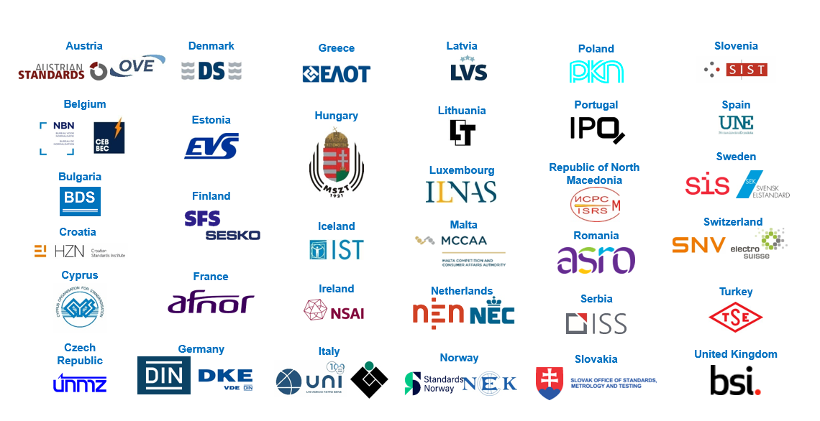
The European Standardization System
National
European
International

Slide 3
Towards global trade
Europe’s preference → Global solutions whenever possible
INTERNATIONAL LEVEL
Vienna Agreement → 34% CEN portfolio identical to ISO
Frankfurt Agreement → 74% CENELEC portfolio identical to (+ 6% based on) IEC
EUROPEAN LEVEL
National Standardization Organizations/ National Electrotechnical Committees
NATIONAL LEVEL

Slide 4
Digital transformation of industry
European industry is increasingly using digital technologies
Traditional sectors like the energy sector need ICT standardization responses
Rapidly evolving regulatory landscape
Growing number of standardization providers
R&D-led growth
Servitization

Slide 5
Twin transition of the energy sector
Digital sector (AI, Cybersecurity, blockchain, IoT, …)
Appliances
Machines
Energy
Home
Mobility
Health
(…)
Digital transformation of Energy Sectors → Internet of Energy
Digital sectors increasingly engaging with vertical sectors → breaking silos
All stakeholders to be involved

Slide 6
Standardization responding to the digital challenge
CEN and CENELEC meet the needs of industry sectors that digitally transform providing the relevant set of standards
→ Digital transformation of industry
Make the CEN and CENELEC system more agile and adaptable to market and technology innovation
→ Digital transformation CEN and CENELEC and its deliverables

Slide 7
Integrating standardization in Horizon Europe projects

Slide 8
CEN and CENELEC looking to the future

Slide 9
Thank you for your attention
Elena Santiago-Cid
CEN and CENELEC Director General

