Slide 1
REGIONAL ENERGY SECURITY IN THE CONTEXT OF THE
EUROPEAN INTERNAL ENERGY MARKET

Slide 2
Securing the Smart Grid through Innovation and Digitalization
Mihai PAUN
Vice-President
Romanian Energy Center
5 June 2018, Brussels

Slide 3
Objectives:
Facilitate Dialog with Industry representatives on how to address innovation and digitalization, by putting the right infrastructure in place
Address the next decade’s challenges for the electricity grids, regulation and governance and provide insights and solutions through innovative projects and demonstrators
Analyse sectorial integration, as well as integrated energy market in the Central and South-Eastern region.
Notes:
Discussions will focus this 7th year edition of the Romanian Energy Day on the next decade’s challenges for the power grids and provide insights and solutions through innovative projects, demonstrators and pilots. Special attention will be devoted to sectorial integration, as well as integrated energy market in the Central and South-Eastern region. Participants will be faced with industry representatives in a dialogue on how to maximize renewable energy sources integration through innovation and digitalization, by putting the right infrastructure in place.
The interconnection of Smart Grids operating in different MS is already happening at TSO level but there is a need of more coordination between the TSOs and DSOs and also amongst DSOs.
There is a need for more integration of the distribution grid and the transmission systems to enable digital and physical interconnections at the distribution level and cross-borders in the future. There are synergies to be exploited amongst the Telecoms, Energy and Transport sectors in terms of digitisation and infrastructures. Close collaboration amongst these sectors is needed in order to use resources efficiently and effectively. A Networking Exhibition will also showcase R&D&I Projects with a European scope that will present their work and results.

Slide 4
TOPICS:
Interconnection of Smart Grids operating in different MS is already happening at TSO level but there is a need of more coordination between the TSOs and DSOs and also amongst DSOs.
ENERGY PACKAGE
Need for more integration of the electricity distribution grid and the transmission systems to enable digital and physical interconnections at the distribution level and cross-borders in the future
There are synergies to be exploited amongst the Telecoms, Energy and Transport sectors in terms of ICT, digitalization and infrastructures
Close collaboration amongst these sectors is needed in order to use resources efficiently and effectively.
A Networking Exhibition on showcase RD&I Projects with a European scope – implementation and results.
Notes:
Discussions will focus this 7th year edition of the Romanian Energy Day on the next decade’s challenges for the power grids and provide insights and solutions through innovative projects, demonstrators and pilots. Special attention will be devoted to sectorial integration, as well as integrated energy market in the Central and South-Eastern region. Participants will be faced with industry representatives in a dialogue on how to maximize renewable energy sources integration through innovation and digitalization, by putting the right infrastructure in place.
The interconnection of Smart Grids operating in different MS is already happening at TSO level but there is a need of more coordination between the TSOs and DSOs and also amongst DSOs.
There is a need for more integration of the distribution grid and the transmission systems to enable digital and physical interconnections at the distribution level and cross-borders in the future. There are synergies to be exploited amongst the Telecoms, Energy and Transport sectors in terms of digitisation and infrastructures. Close collaboration amongst these sectors is needed in order to use resources efficiently and effectively. A Networking Exhibition will also showcase R&D&I Projects with a European scope that will present their work and results.

Slide 5
Keynote Presentations:
Andreea STRĂCHINESCU, HoU New Energy Technologies and Innovation, DG ENER, European Commission
Merce GRIERA I FISA, Head of Research and Innovation Sector, DG CONNECT, European Commission
Panelists:
Georgios STASSIS, Country Manager, Enel Romania
Manuel SANCHEZ-JIMENEZ, Team Leader Smart Grids, DG ENER, European Commission
Adrian BOROTEA, Director of Strategy, CEZ Romania
Károly BORBÉLY, Director Public Affairs, Telekom Romania
Valeriu BINIG, Business Advisory Partner, EY Romania
Massimo BERTONCINI, Director, Engineering Ingegneria Informatica, Italy
Antonio MARQUES, Director of Technology, Grupo ETRA, Spain
Mădălina Mirela POPA, Group Sales and Marketing Director, Automobile Bavaria Group
Ronan MURPHY, Smart Networks Specialist, ESB Electricity Supply Board, Ireland
MODERATOR: Mihai PĂUN, Vice-President, Romanian Energy Center

Slide 6
QUESTION 1:
WHAT KIND OF FRAMEWORK IS NEEDED TO ALLOW ENERGY AND ICT UTILITIES TO INVEST?

Slide 7
QUESTION 2:
WHAT IS RELATIONSHIP BETWEEN REGULATION, INNOVATION AND DIGITALIZATION?
SUPPORT
CHALLENGE
REAL BARRIER
WHY?

Slide 8
QUESTIONS FROM THE AUDIENCE:

Slide 9
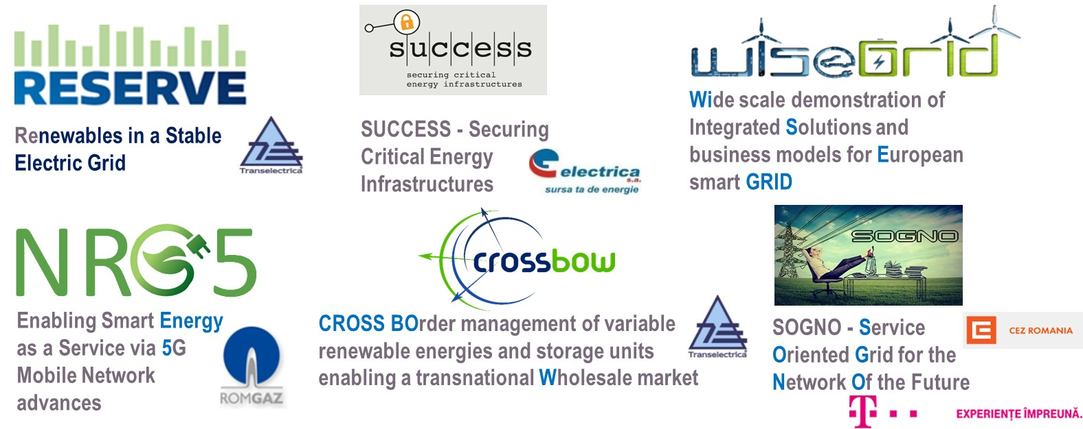
INNOVATION @ CRE - EU projects implementation

Slide 10
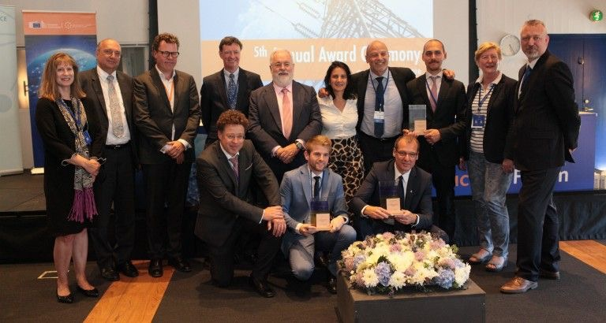
WiseGRID consortium receives ‘Good Practice of the Year’ awards from Commissioner for Energy, Miguel Arias Cañete
Technology
and
Design
Energy Infrastructure Forum 24 May Copenhagen

Slide 11
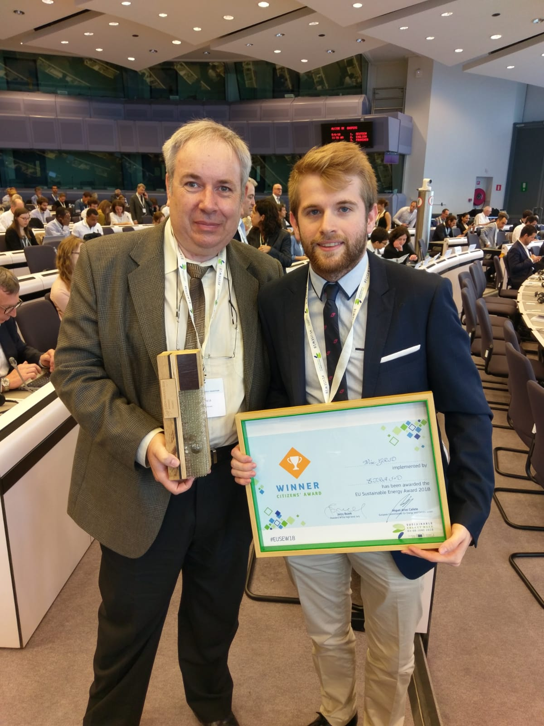
WiseGRID PROJECT IS AWARDED THE BUSINESS AND CITIZENS AWARDS
AT EUSEW 2018
Energy Infrastructure Forum 24 May Copenhagen

Slide 12
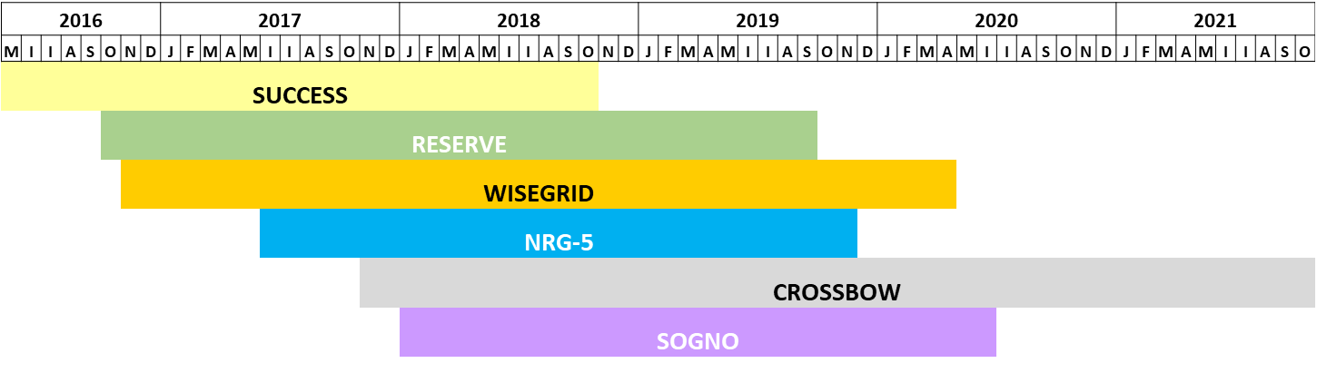
CRE – EU projects implementation

Slide 13
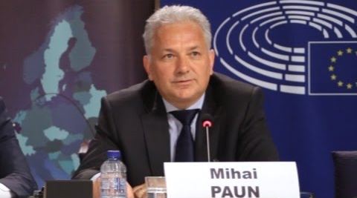
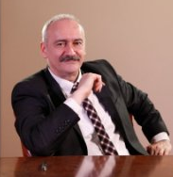
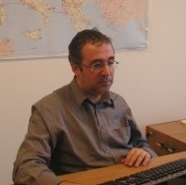

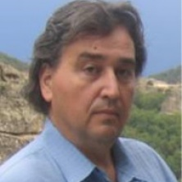

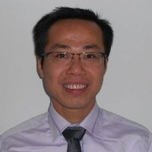
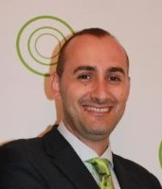
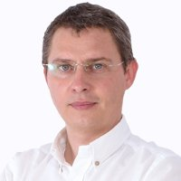
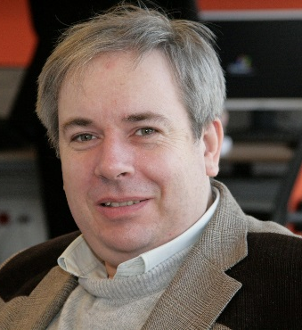
CRE TEAM – EU H2020 proJECTS
Mihai PAUN
Catalin CHIMIREL
Dan PREOTESCU
Irina NITA
Mihai SANDULEAC
Thong VU VAN
Mihai MACARIE
Mihai MLADIN
Paul LACATUS
Slide No. 13 © CRE 2017 All rights reserved.

Slide 14

Thank you for your attention!
Mihai PAUN
Vice-President
Romanian Energy Center
mihai.paun@crenerg.org

